Slide 1

One, two, three, riddle-dee-dee!

Slide 2

Welcome to the magic island!

Slide 3

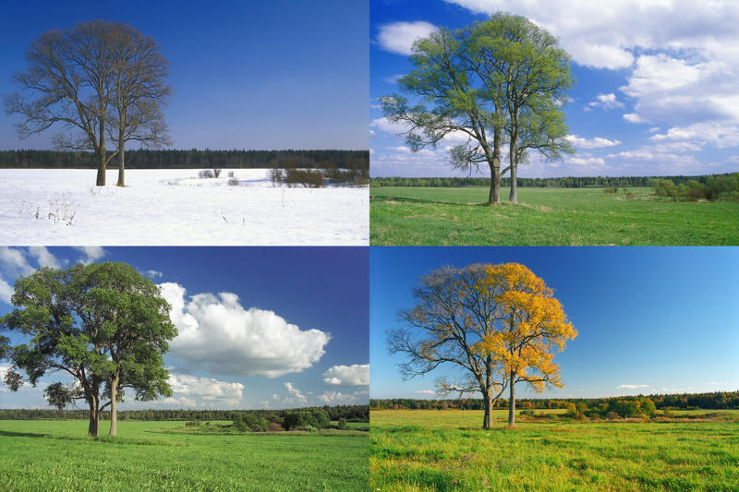
4 seasons: spring summer autumn winter

Slide 4
A
B
C

Slide 5
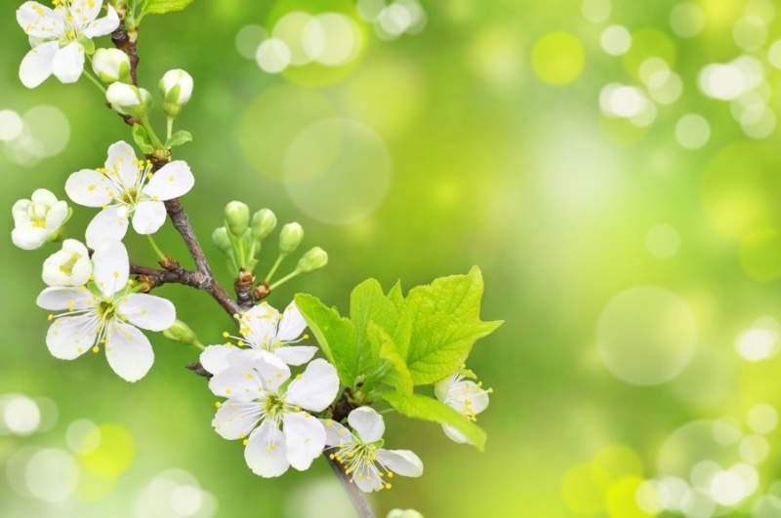
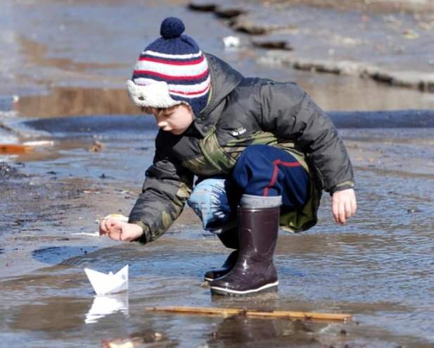
SPRING

Slide 6

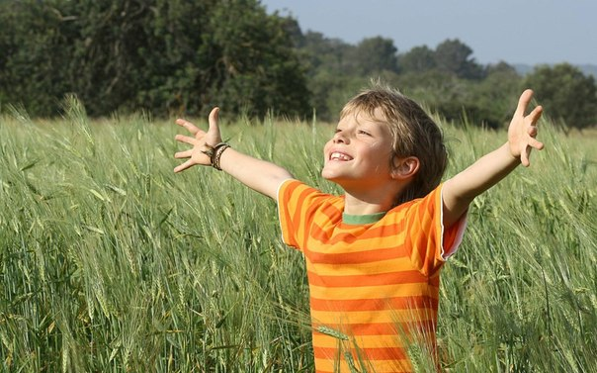
SUMMER

Slide 7

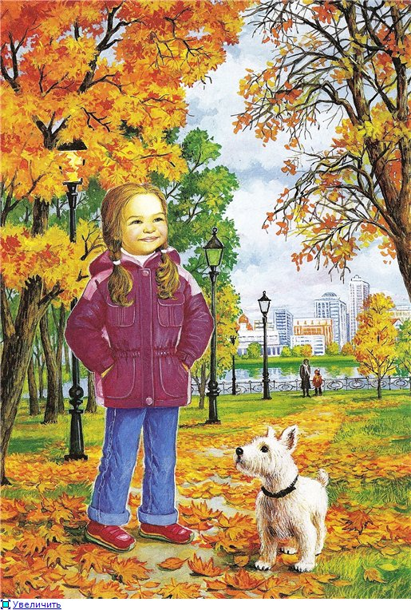
AUTUMN

Slide 8

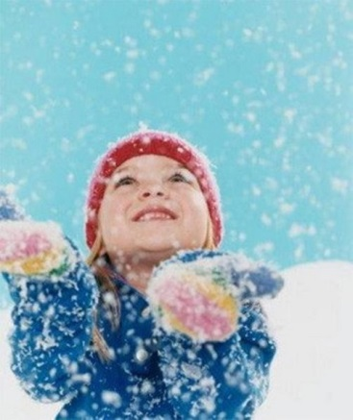
WINTER

Slide 9
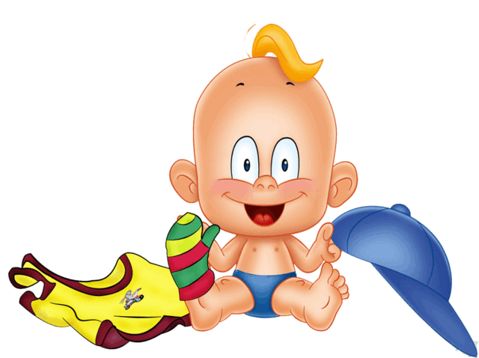
Every day!
Every day I put on my …, I put on my …, Every day
Every day I put on my …, I put on my …, Every day
Every day I put on my …, I put on my …, I put on my …, Every day
Every day I put on my …, I put on my …, I put on my …, I put on my …, Every day.
Good bye, Mum!

