Slide 1

Hello children!
How are you today?
Let’s learn a new tongue-twister
[æ]
Sam has a hat. Sam has a black hat. Sam has a black hat in his hand.

Slide 2
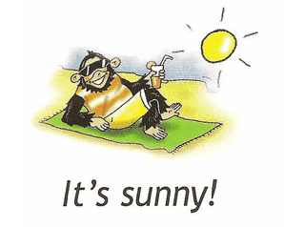
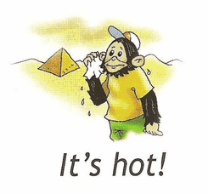
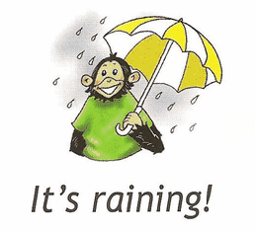
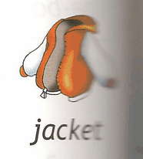

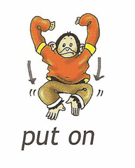
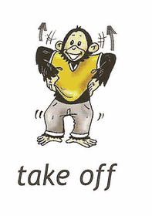



Slide 3
надеть
снять

Slide 4

What’s the weather like? Какая погода?
It’s sunny!

Slide 5
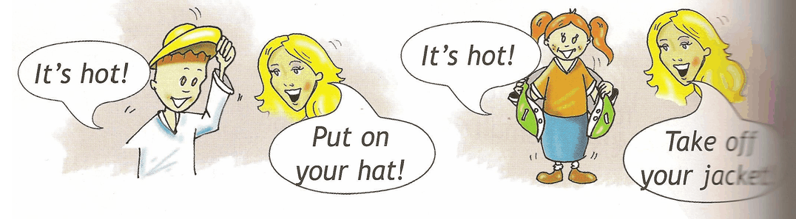
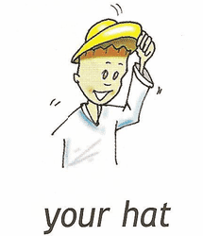

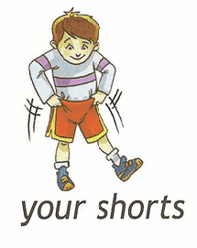
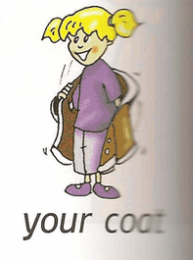
It’s time to talk!

Slide 6
Let’s play!

Slide 7
Let’s have a break and do exercises!
Two little feet go tap, tap, tap.
Two little hands go clap, clap, clap.
Two little hands go thump, thump, thump.
Two little feet go jump, jump, jump.
My one body turns around
And it quietly sit down.

Slide 8
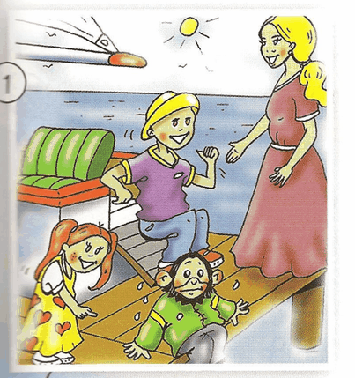
Listen and read
go in the boat – плыть на лодке
Of course! – Конечно!
I’m wearing my hat! – На мне шляпа!
Summer holidays – летние каникулы
Help! – Помогите!
- Who can you see in the picture?
Chuckles, Lulu, Larry and Nanny Shine
- They’re on holiday. They want to go in the boat. Are they sab or happy?
They’re happy!

