Slide 1
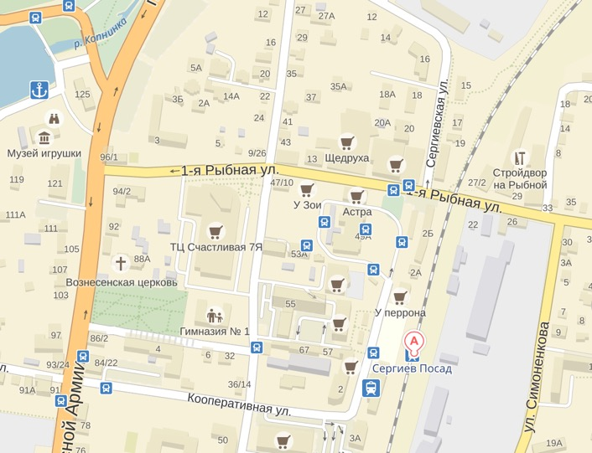

Slide 2
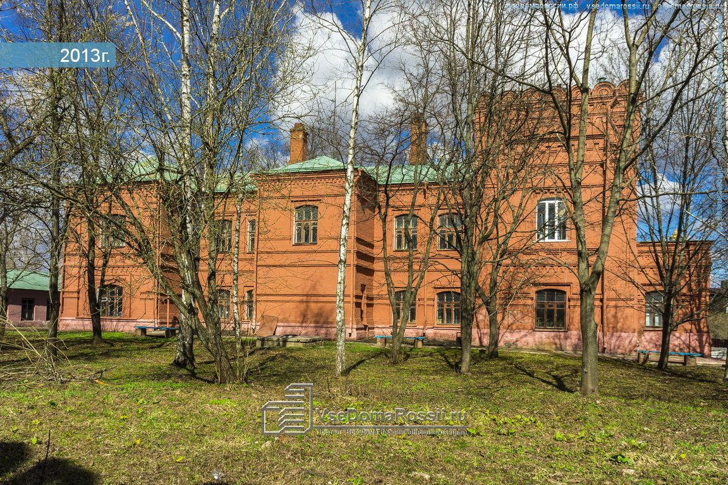

Slide 3
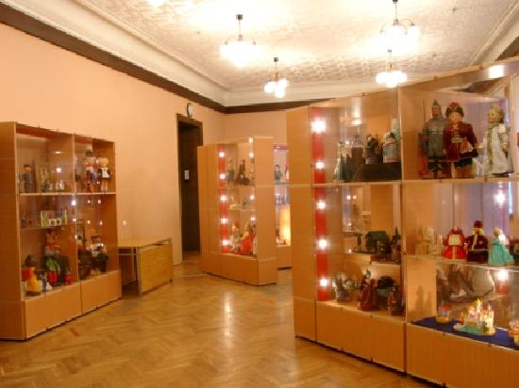

Slide 5
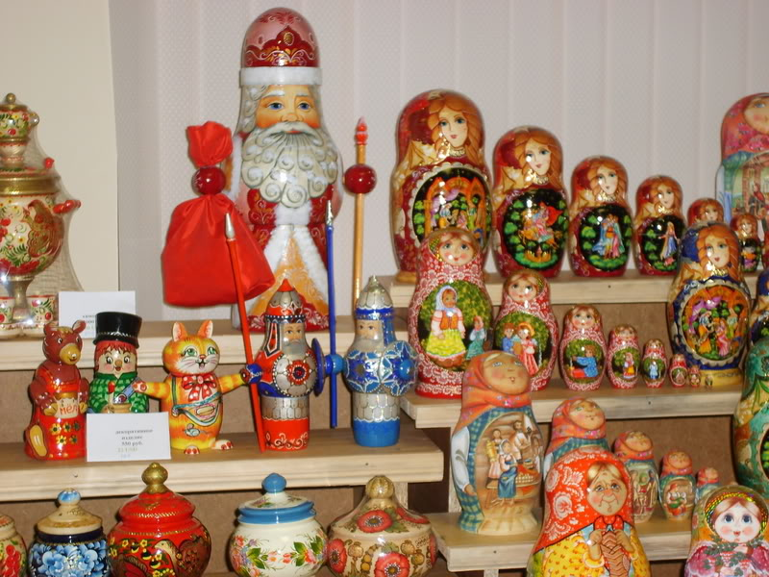

Slide 6
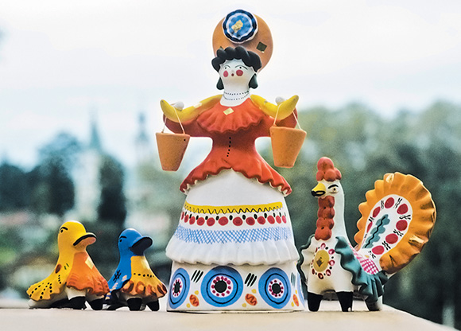

Slide 7
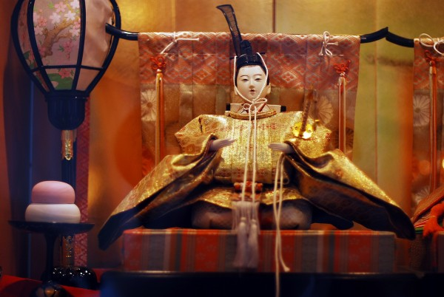

Slide 8
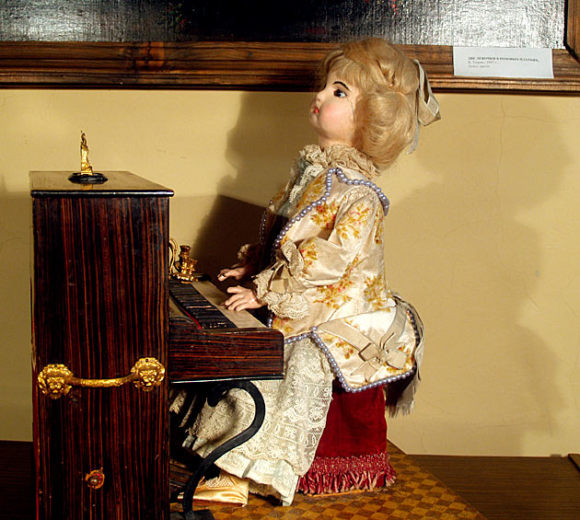

Slide 9
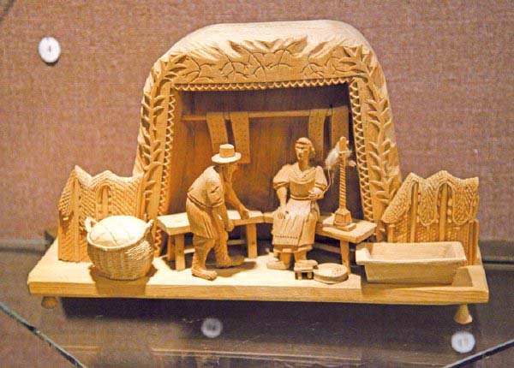

Slide 10
Questions:
Where is Sergiev Posad?
What is Sergiev Posad famous for?
What museum have they got?
How many toys are in the museum?
Which kinds of toys are there?
Are there electronics toys?

Slide 11
Imagine you went to the Toy Museum last Friday. Did you like the visit? What did you see there?
Last Friday I went to/visited the Toy Museum in ....
In this museum I saw matryoshkas, .......
I really liked/enjoyed this visit.
And I think you must go there some day.

Slide 12
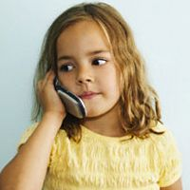
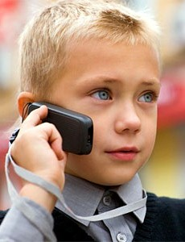
Hi! Where ___________ (you/go) last week?
I ___________ (go) to the toy museum!
What _________ (you/see)?
I ___________ (see) dolls,
matryoshkas, toy soldiers!
- ___________
(you/like) them?
- Yes, I ______.
Most of all I _________ (like)
toy soldiers of Red Army!
- Wow! Great!

Slide 13
Hi! Where did you go last week?
I went to the toy museum!
What did you see?
I saw dolls,
matryoshkas, toy soldiers!
- Did you like
them?
- Yes, I did.
Most of all I liked
toy soldiers of Red Army!
- Wow! Great!

